Slide 1
Machine Monitoring SysTEm
มจพ. และ
ดร.พสิษฐ์ ธนาโชติอนันต์กุล

Slide 2
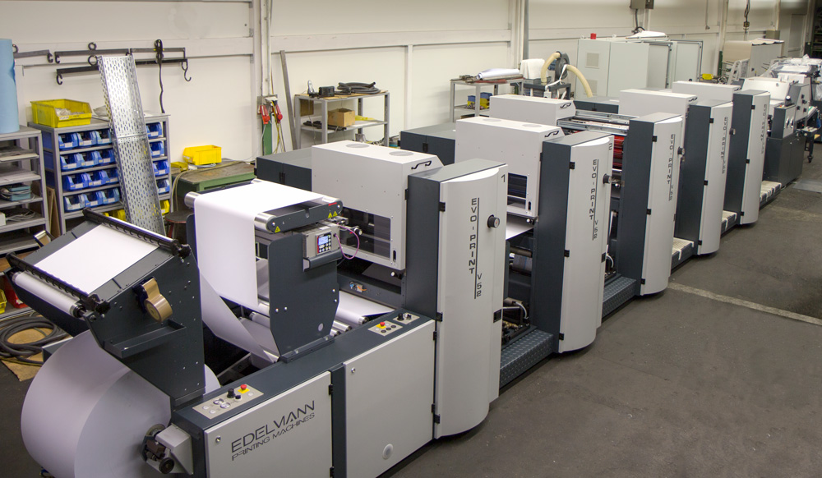
ระบบ Machine Monitoring
Output Quantity vs. Cycle Time
Good vs Defect
Planned Run Time vs. Run Time

Slide 3
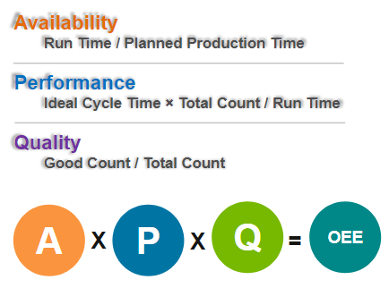
Overall equipment effectiveness (OEE)
Metrics | Measurement | Devices
Run Time | On/Off Switch or PLC output | On-Off Button or Output from PLC
Planned Production Time | Constant value | -
Ideal cycle time | Constant value | -
Total count | 2. Total Counter | Proximity sensor
Good Count | 3. Good Counter | Proximity sensor

Slide 4
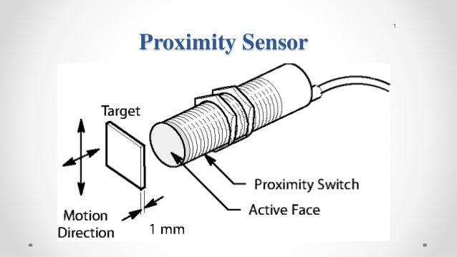
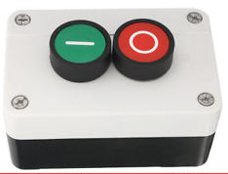
ระบบ Machine Monitoring
Total Qty
Sensor Controller
Good Qty
Run/Off Switch

Slide 5

ระบบ Machine Monitoring
Cloud Computing
Total Qty
Monitoring Software
Sensor Controller
Ethernet shield
mySQL
Good Qty
Run/Off Switch
Factory
Client

Slide 6
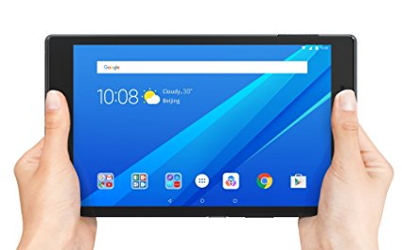
ระบบ Machine Monitoring
Cloud Computing
Total Qty
Ethernet shield
Sensor Controller
Monitoring Software
mySQL
Good Qty
Local
mySQL server
Run/Off Switch
Factory
Client

Slide 7
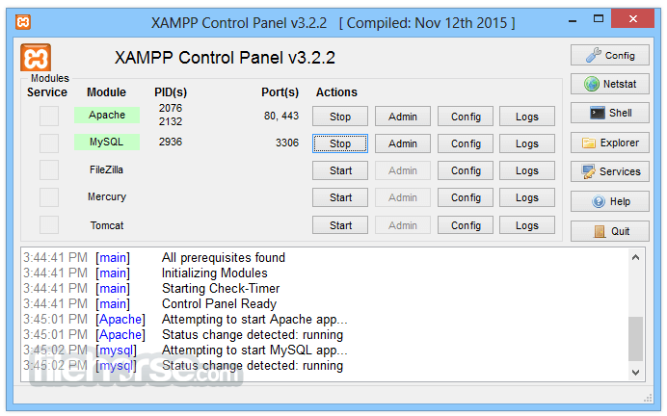
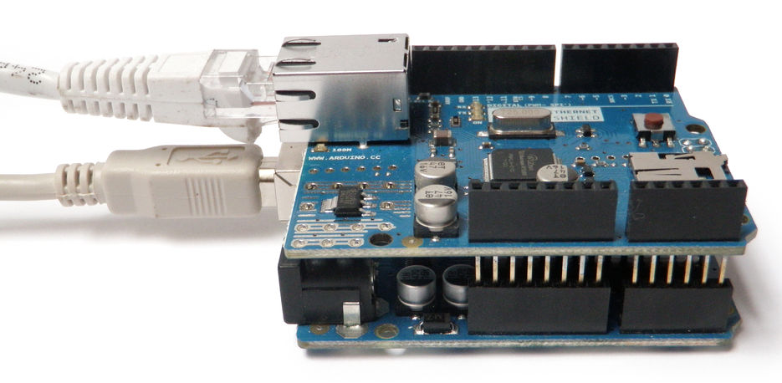
network
Application
mySQL

Slide 8
ขั้นตอนการลงโปรแกรม
Install xampp (mysql + phpmyadmin)
Config mysql to start when server is on. Set user name and password to access to mysql.
Copy files into htdocs (checkpassword2.php, postmysql.php, dataform.php, machine.php)
connect grafana on server
Connect sensor controller to machine and network

Slide 9
exit
continue
Home page
Data Enter
Post to mySQL
machine.php
dataform3.php
postmysql.php
Login Form
Data Form

Slide 10
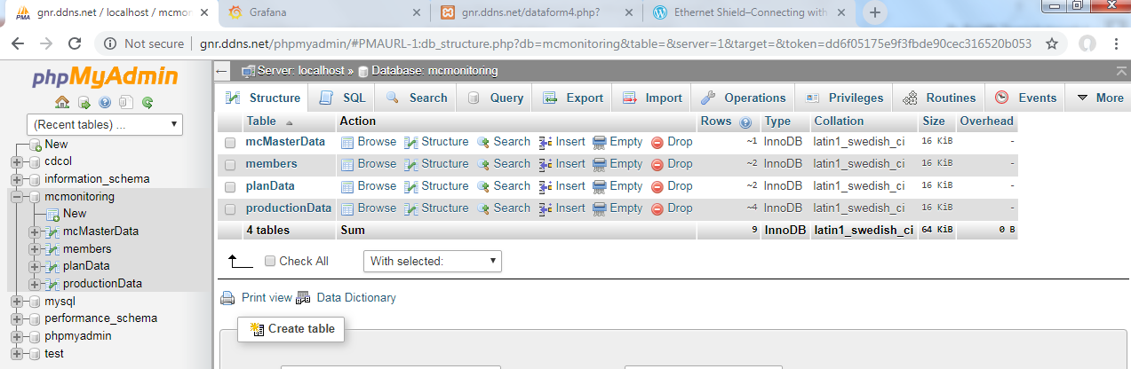

Slide 11
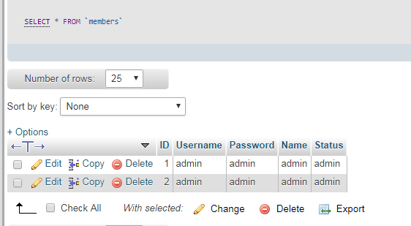
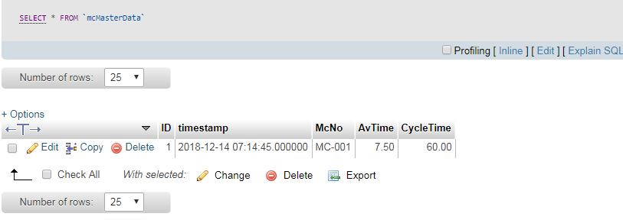

Slide 12
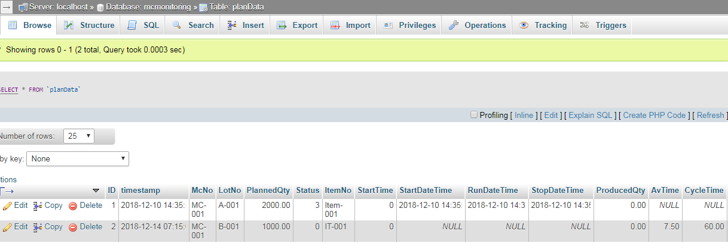

Slide 13
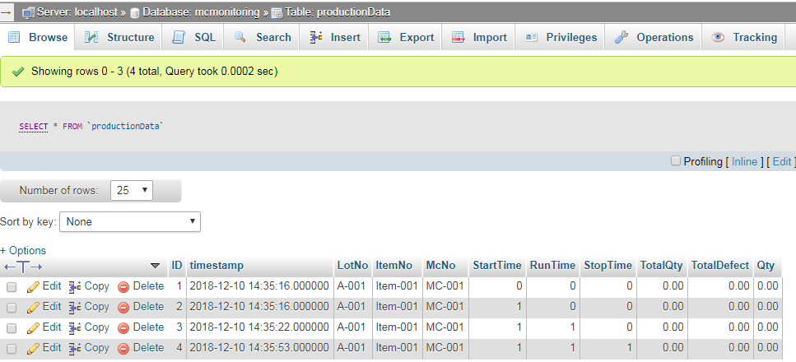

Slide 14
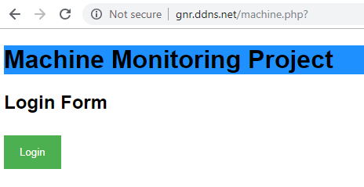
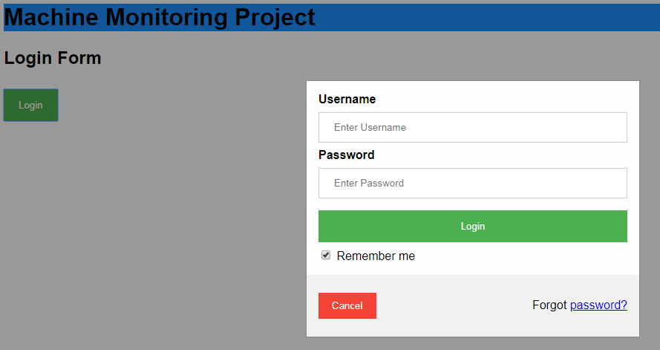

Slide 15
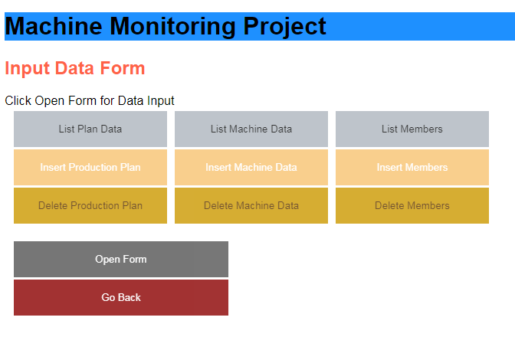

Slide 16
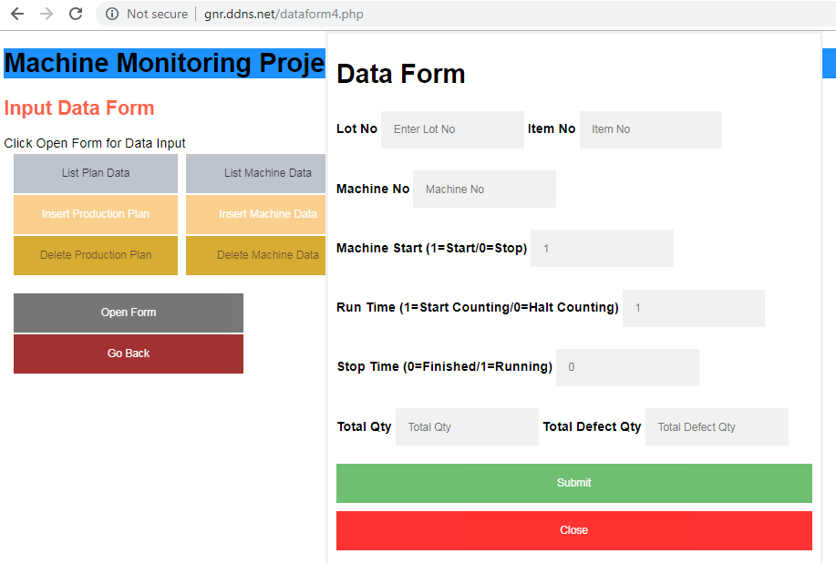

Slide 17
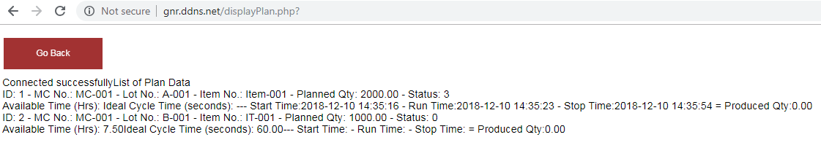
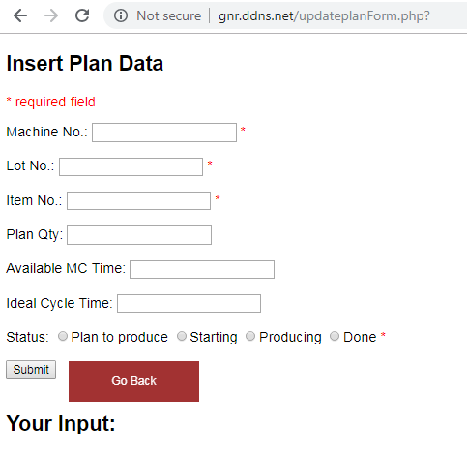
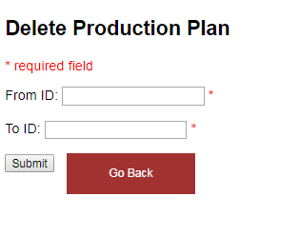

Slide 20
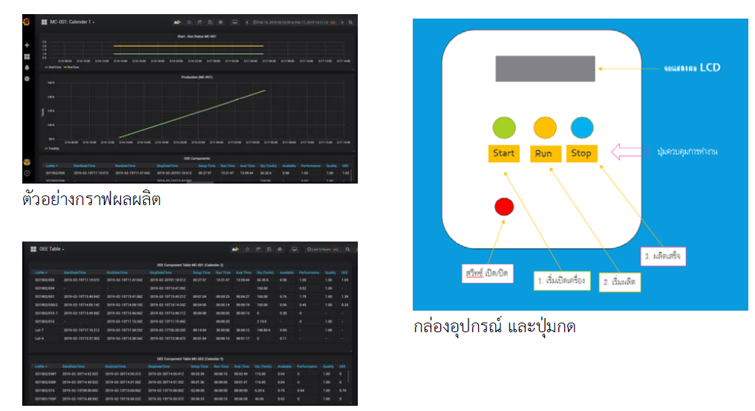

Slide 21
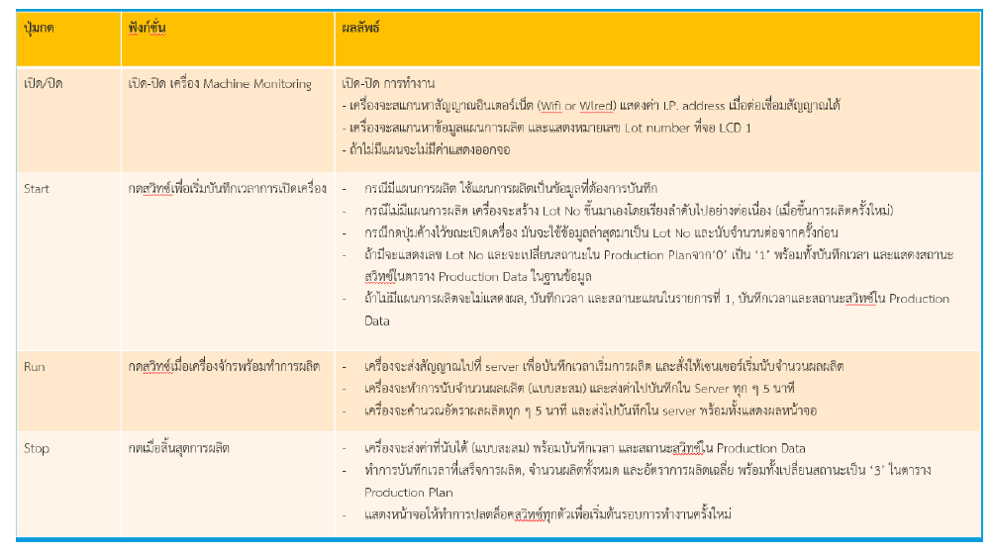

Slide 22
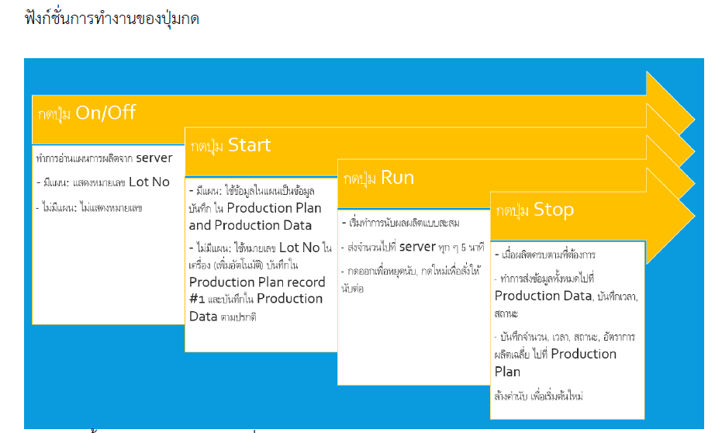

Slide 23
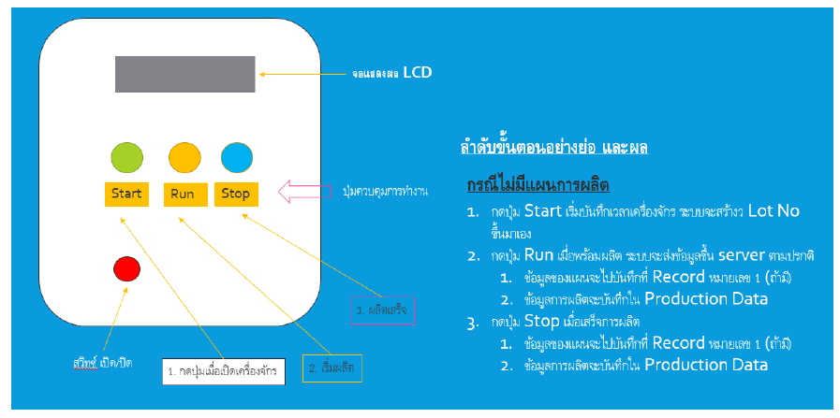

Slide 24
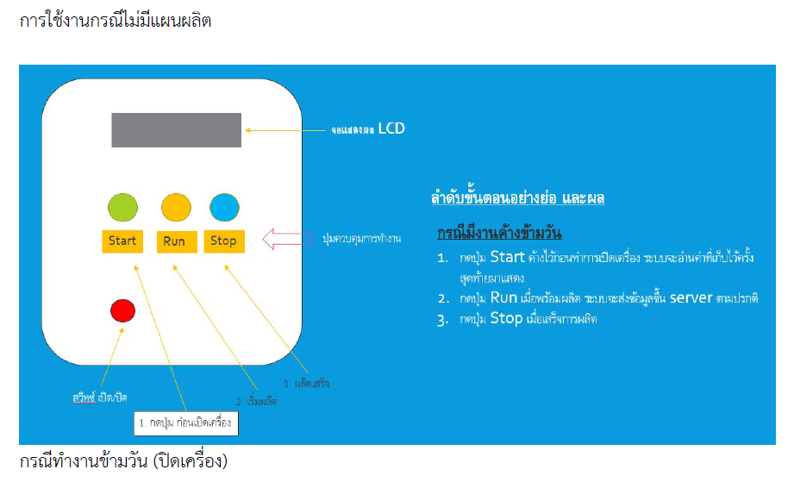

Slide 25
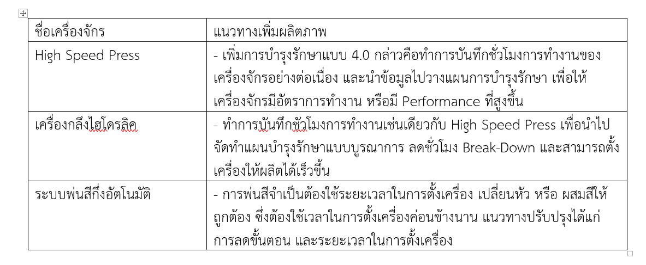

Slide 26
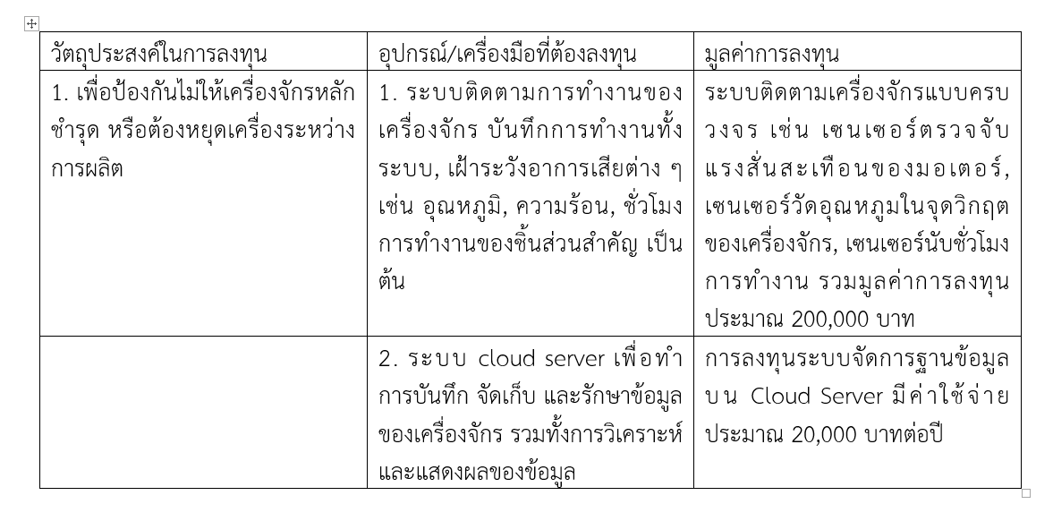

Slide 27
Prod. Plan
Start Button
Setup
Run Button
Run Button
Breakdown
Producing
Fixed
Run Button
Stop
Qty/min
Timestamp
Timestamp
Prod. Plan
Timestamp
Accm Qty
Timestamp
Timestamp
Timestamp
Prod. Plan

Slide 28
THE END

